Slide 1

TEAM – DATA MINDS(ON02)

Slide 2




IOT AND DATA SCIENCE
BASED SOLUTION FOR
CARDIO-RESPIRATORY PATIENTS
ENVIRO-PREDICT HEALTH GUARD+
PROJECT PROPOSAL

Slide 3

Content
Problem Statement
Project Scope
Introduction
IOT COMPONENTS
AND TECH
IMPLEMENTATION
MODEL DIAGRAM
Data Analysis
Personalized Recommendations
BUSINESS POTENTIAL

Slide 4


INTRODUCTION
"EnviroPredict HealthGuard" is a cutting-edge initiative that combines IoT technology, data science, and healthcare to address the crucial link between environmental conditions and public health. By monitoring real-time pollution data and tailoring recommendations to asthma and heart patients, this project strives to empower individuals with the knowledge they need to make informed decisions about their well-being in our ever-changing urban environments.

Slide 5

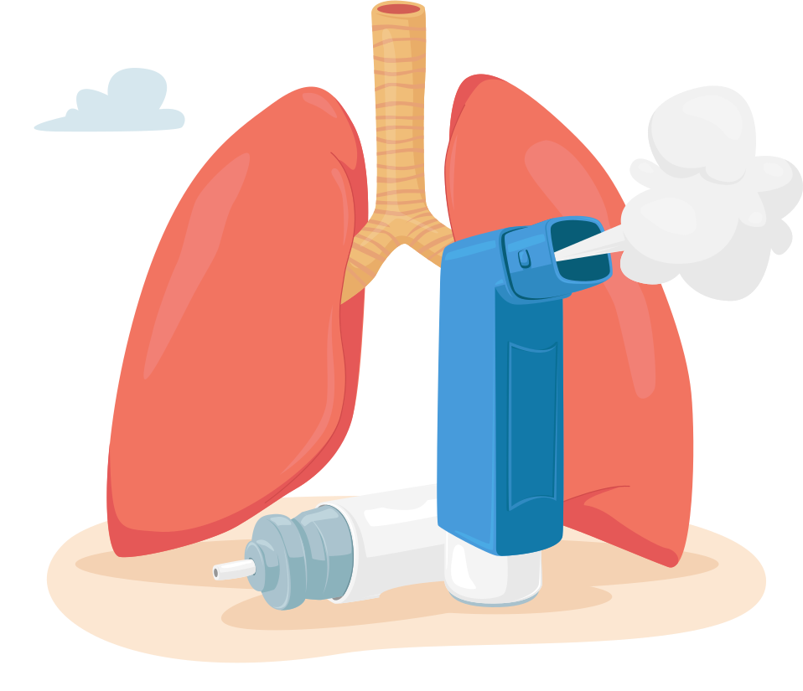
Problem Statement
Asthma and heart patients are susceptible to adverse health effects resulting from environmental factors, including air quality, noise pollution, and indoor pollutants. There is a pressing need for a comprehensive predictive analysis and recommendation system to monitor and assess these environmental conditions in real-time. This system must provide timely alerts and recommendations to empower patients with the information necessary to make informed decisions, ultimately safeguarding their health and well-being.

Slide 6





Sensor Deployment:
Choose and deploy a network of sensors, including PM2.5, CO2, sound level, temperature, and humidity sensors, in both indoor and outdoor environments. Ensure proper calibration and maintenance.
Data Integration:
Develop processes to clean and preprocess incoming data, handling missing values, outliers, and data format conversions.
IMPLEMENTATION
Create meaningful features by combining sensor data and health records to capture environmental and health-related factors effectively.
Develop machine learning models that use historical data to predict potential health risks for patients based on current environmental conditions.
Predictive Analysis:
Alerting Mechanism
Implement an alerting system that generates alerts when environmental conditions pose a risk to the health of asthma and heart patients.

Slide 7
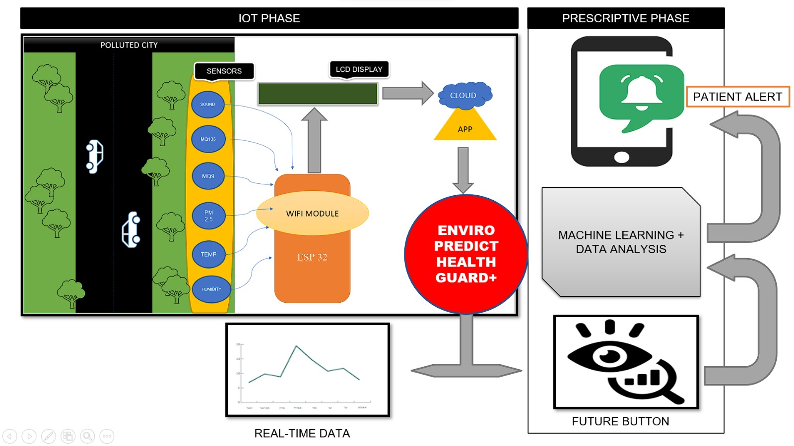

Slide 8
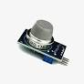
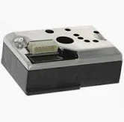


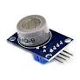
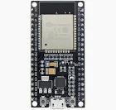
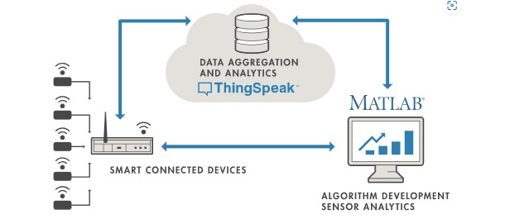
AS THIS IS A MODEL FORM OF OUTPUT WE HAVE USED A BASIC SENSORS FOR SENSING THE ENVIRONMENTAL PARAMETERS WHICH AFFECTS CARDIO-RESPIRATORY PATIENTS
THINGS SPEAK
IOT ANALYTICS PLATFORM

Slide 9
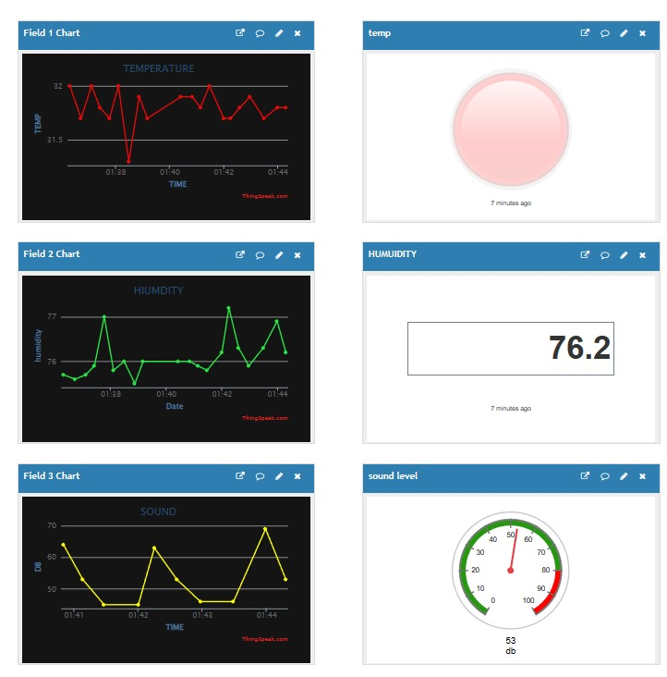
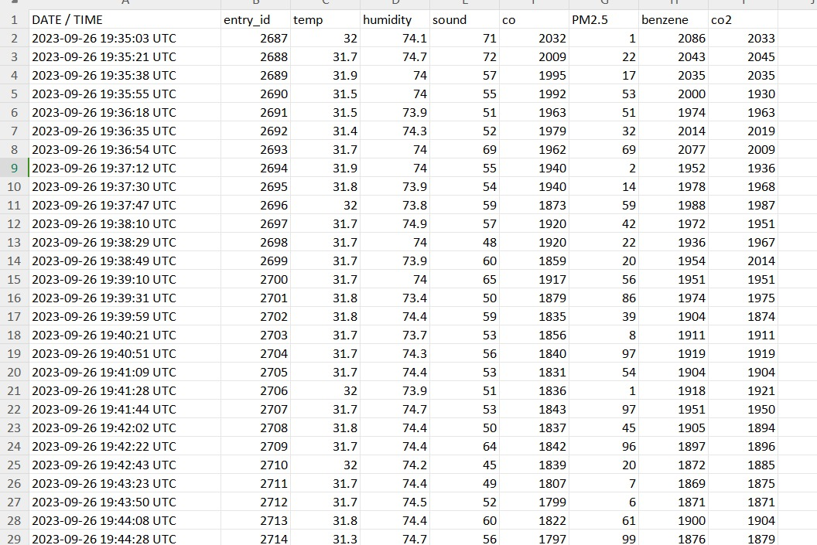
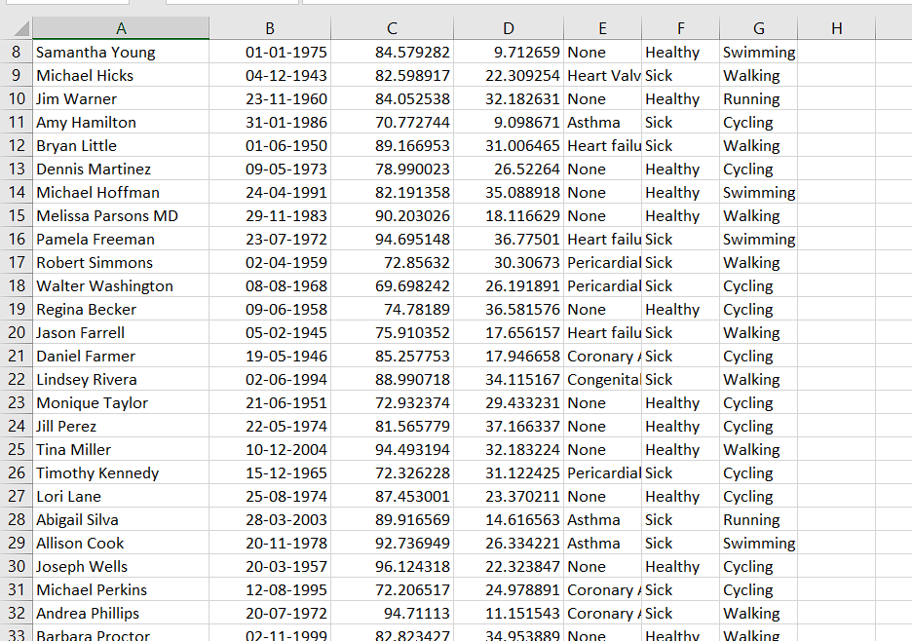
DATA COLLECTION
DATA ANALYSIS

Slide 10
DATA CLEANING, WRANGLING AND VISUALISATION
Two datasets i.e. user health data and the City data
The user data contained the information about users such as health bio data and activities as well as their location.
The City data contained the different cities in terms of latitudes and longitudes, pm2.5 values,Temp & humidity CO, CO2, Benzene and so on.
Both datasets were cleaned by dropping missing values of the selected columns and then visualised it.
DATA ANALYSIS

Slide 11
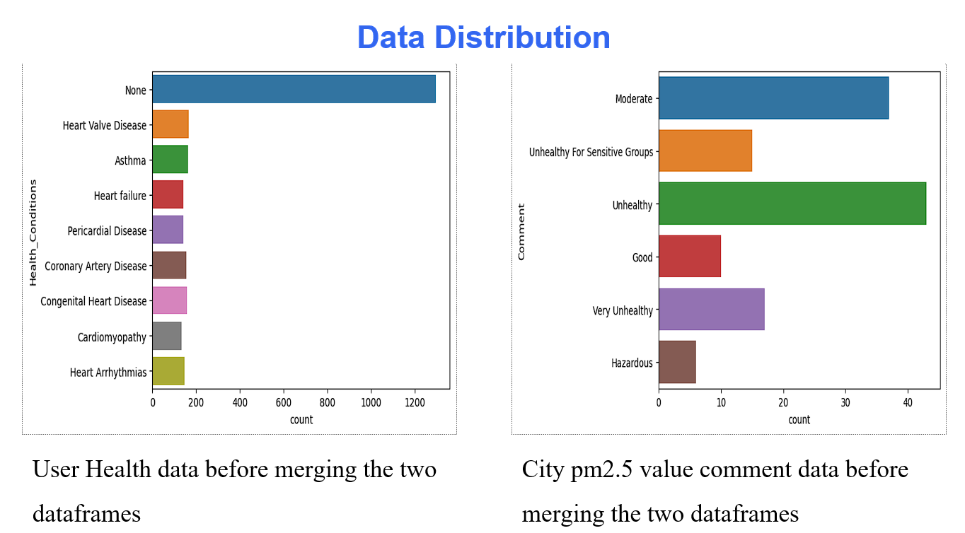
DATA CLEANING, WRANGLING AND VISUALISATION
DATA ANALYSIS

Slide 12
DATA TRAINING
Data was split into training and test data in the proportion of 7:3.
It was scaled up so as it is kinda relative.
Different algorithms used like Support Vector Machine, decision tree, Logistic Regression, Decision Tree, and KNN.
Techniques to improve accuracy
Hyperparameter tuning using gridsearch and random search (provided the best)
DATA ANALYSIS

Slide 13
DEPLOYMENT OF MODEL
the Decision Tree algorithm has outperformed other algorithms and is considered the best choice for your "EnviroPredict HealthGuard" project. Decision Trees are known for their interpretability and ability to handle both classification and regression tasks effectively. Here are some key advantages of using Decision Trees
Decision Trees provide a clear, visual representation of decision rules, making it easier to understand how the model reaches its predictions. This interpretability is crucial for healthcare applications where transparency is essential.
DATA ANALYSIS

Slide 14


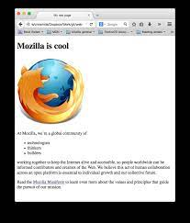
Implement an alerting system that compares the patient's travel plans with the predictive models and environmental thresholds.
Generate alerts if the system predicts that environmental conditions at the travel destination may pose a risk to the patient's health.
PERSONALIZED RECOMMENDATIONS

Slide 15
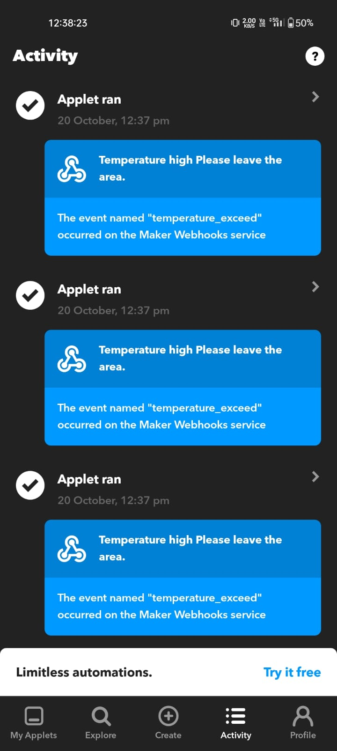
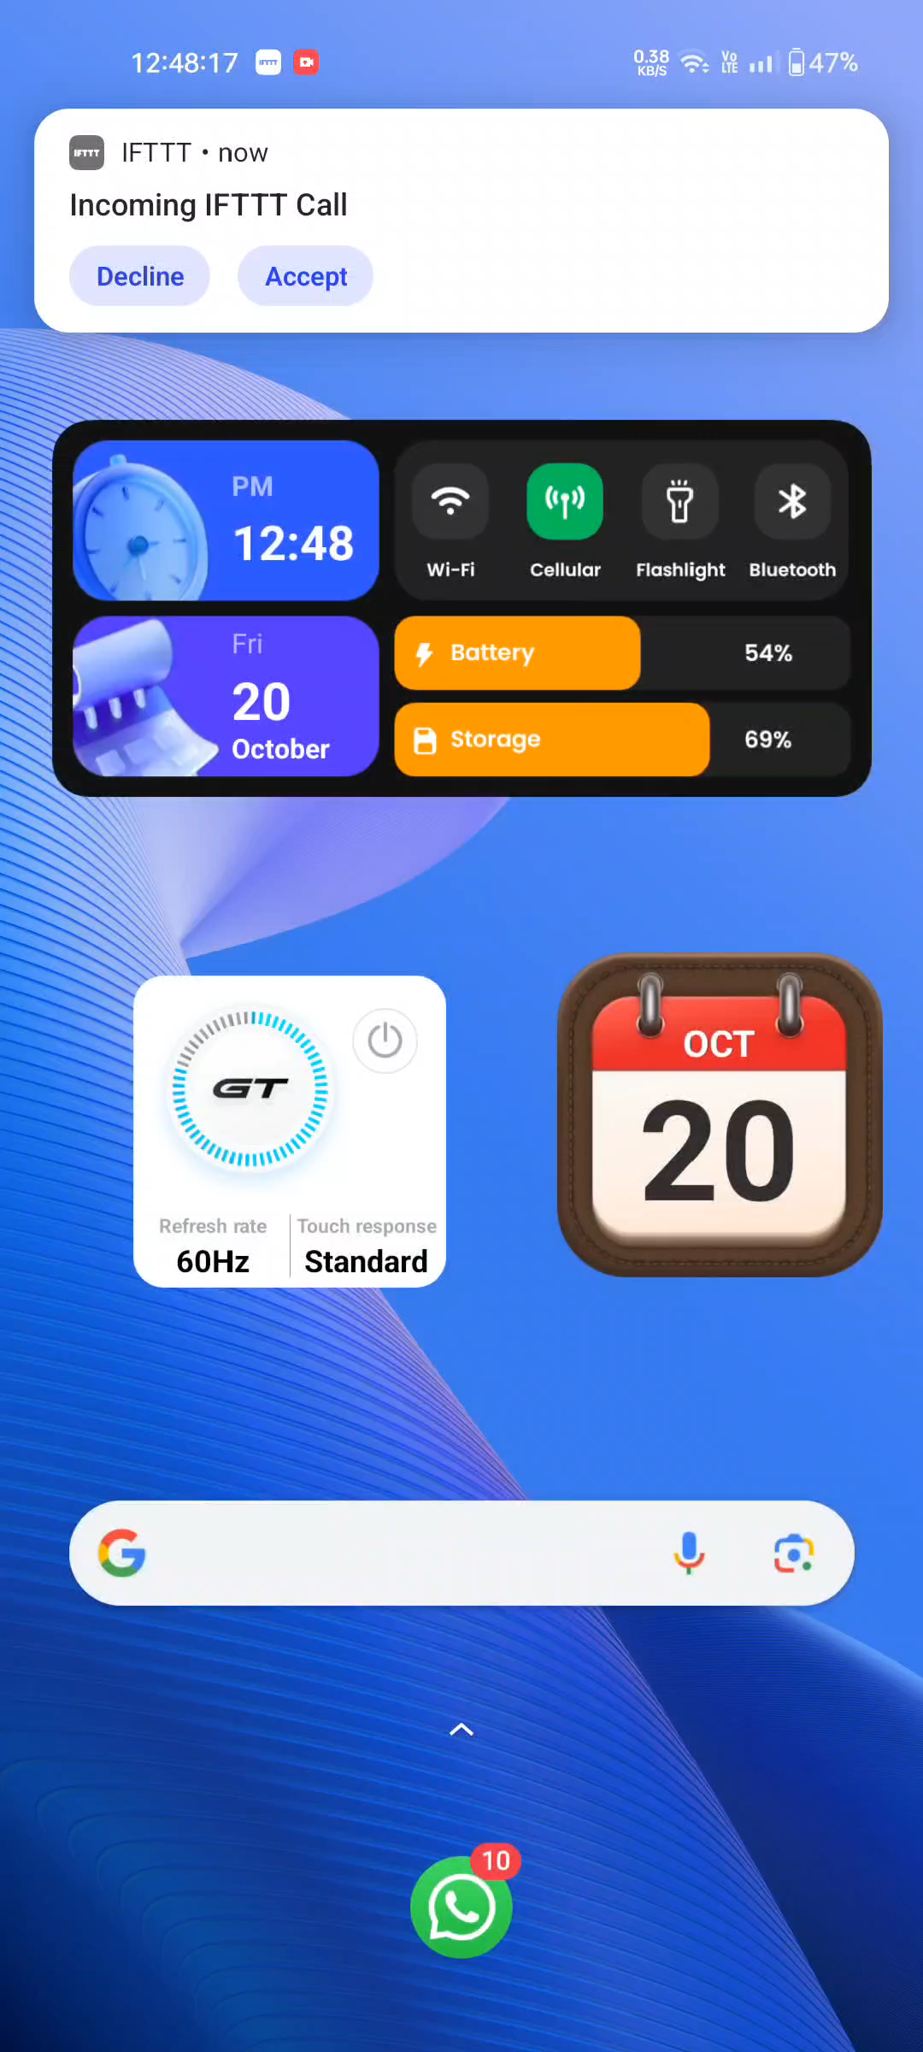
RECOMMENDATION ALERT MESSAGE
RECOMMENDATION CALL
ENVIRO – PREDICT HEALTHGUARD+

Slide 16

BUSINESS POTENTIAL
Hospital Partnerships
Demonstrated Value
Research and Policy Impact

